Slide 1
PIP4004 - INTERNSHIP Review-3 Presentation .Net Website Development Using VS Community
Student Details
Name | SANIYA KOUSAR
Roll No | 20211CIT0142
Section | 8CIT-02
Batch No.
Under the Supervision of,
Dr SHARMASTH VALI Y
Associate Professor
School of Computer Science and Engineering
Presidency University
Name of the Program: CSE-IOT
Name of the HoD: Dr. S P ANANDRAJ
Name of the Program Project Coordinator: Dr.Sharmasth vali
Name of the School Internship/Project Coordinators: Mr. Md Ziaur Rahman /
Dr. Sampath A K / Dr. Abdul Khadar A

Slide 2
Title
Enhancing Web Development with .Net MVC: A Structured Approach

Slide 3
Abstract
The Model-View-Controller (MVC) pattern is a widely used architectural approach for developing scalable, maintainable, and efficient web applications. Microsoft's .NET framework, particularly ASP.NET Core MVC, provides a robust platform for implementing this paradigm effectively. This report explores best practices in .NET website development using MVC, focusing on key principles such as separation of concerns, dependency injection, security enhancements, performance optimization, and scalability. Additionally, it examines the transition from monolithic applications to microservices-based architectures and their benefits. Case studies and industry applications highlight how these practices improve security, efficiency, and overall user experience. By analyzing best practices and modern development trends, this study serves as a comprehensive guide for developers seeking to build high-quality web applications using ASP.NET Core MVC.

Slide 4
Review of Literature
Introduction to MVC
Evolution of the .NET Framework and MVC
Best Practices in MVC-Based Web Development
Separation of Concerns
Dependency Injection
Security Practices
Performance Optimization
Scalability and Microservices in ASP.NET Core MVC
Case Studies and Industry Applications

Slide 5
Objectives
The primary goal of this study is to explore best practices for developing websites using .NET and the Model-View-Controller (MVC) pattern. The specific objectives are:
To understand the MVC architecture – Analyze the role of the Model, View, and Controller in web development and how they contribute to structured application design.
To explore the evolution of .NET and ASP.NET Core MVC – Examine the transition from ASP.NET Web Forms to ASP.NET MVC and further to ASP.NET Core MVC, highlighting the improvements and advantages.
To identify best practices in .NET MVC development – Investigate key development principles such as separation of concerns, dependency injection, security enhancements, and performance optimizations.
To examine security measures in MVC applications – Discuss authentication, authorization, data encryption, and secure coding practices to mitigate risks such as SQL injection and cross-site scripting.

Slide 6
To evaluate performance optimization techniques – Explore caching mechanisms, asynchronous programming, optimized database queries, and response time enhancements in .NET MVC applications.
To compare monolithic and microservices architectures – Analyze the benefits and challenges of transitioning from traditional monolithic applications to microservices-based systems within the .NET ecosystem.
To explore cloud deployment and containerization – Investigate the role of Docker, Kubernetes, and Microsoft Azure in deploying and scaling ASP.NET Core MVC applications.
To study real-world industry applications – Review case studies of businesses implementing ASP.NET Core MVC to understand the practical impact of best practices.
To identify challenges faced by developers – Discuss common issues such as managing dependencies, integrating third-party services, ensuring responsiveness, and maintaining application security.
To provide a comprehensive guide for developers – Offer practical insights and recommendations for implementing best practices in .NET MVC web development for scalability, maintainability, and security.

Slide 7
Problem Statement
Challenges in Traditional Web Development
Lack of scalability in large applications.
Security vulnerabilities in data handling.
Complexity in managing code and UI updates.
Problem Statement
"How can .NET MVC be leveraged to build secure, scalable, and maintainable websites with enhanced performance?"

Slide 8
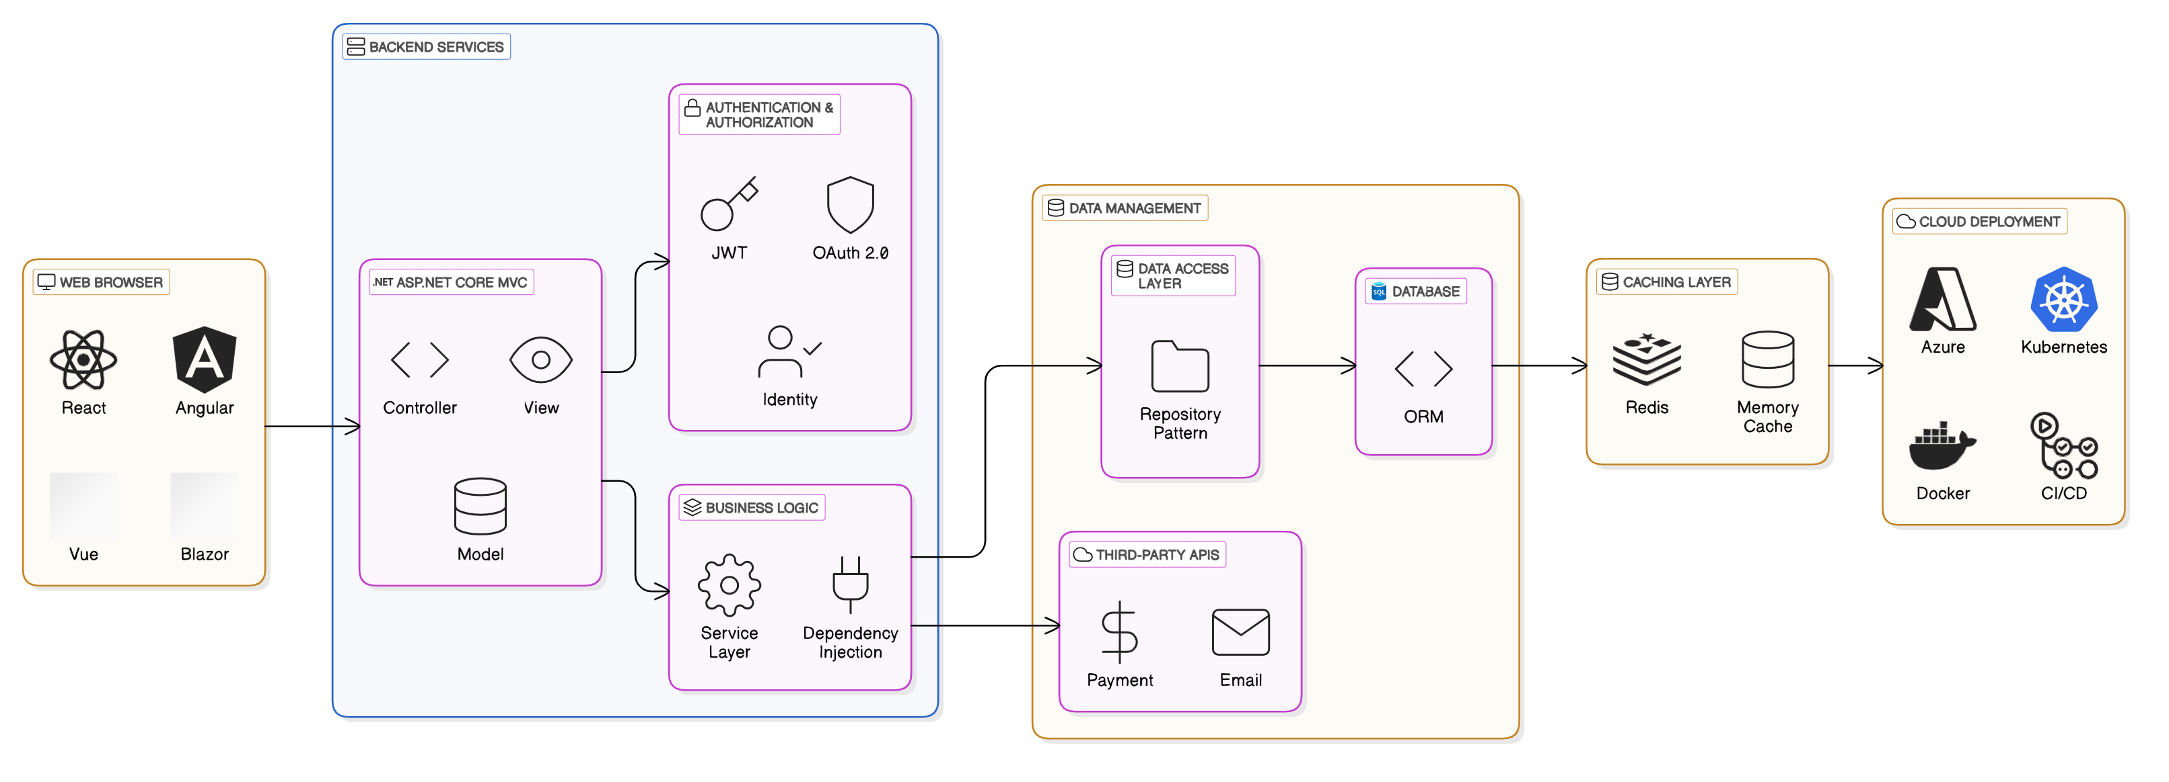
Architecture

Slide 9
Tools and Technologies
Development Tools:
Microsoft Visual Studio – IDE for .NET development
.NET SDK – Framework for building MVC-based applications
C# – Primary programming language for ASP.NET Core MVC
ASP.NET Core MVC – Framework for implementing MVC architecture
Database Management:
SQL Server – Relational database for data management
Security Tools and Techniques:
ASP.NET Identity – Authentication and authorization framework
OAuth & JWT – Secure API authentication techniques
HTTPS & Data Encryption – Security measures for protecting data transmission
Performance Optimization:
Caching (MemoryCache, Redis) – Enhancing speed and reducing database calls
Asynchronous Programming (async/await) – Improving application responsiveness
Load Testing Tools (JMeter, Azure Load Testing) – Evaluating system performance

Slide 10
Performance Metrics Before vs. After Optimization
Metric | Before Optimization | After Optimization | Improvement (%)
Page Load Time (ms) | 1200 ms | 450 ms | 62.5%
API Response Time (ms) | 800 ms | 300 ms | 62.5%
Server CPU Usage | 85% | 55% | 35%
Simultaneous Users | 500 | 2000 | 300%

Slide 11
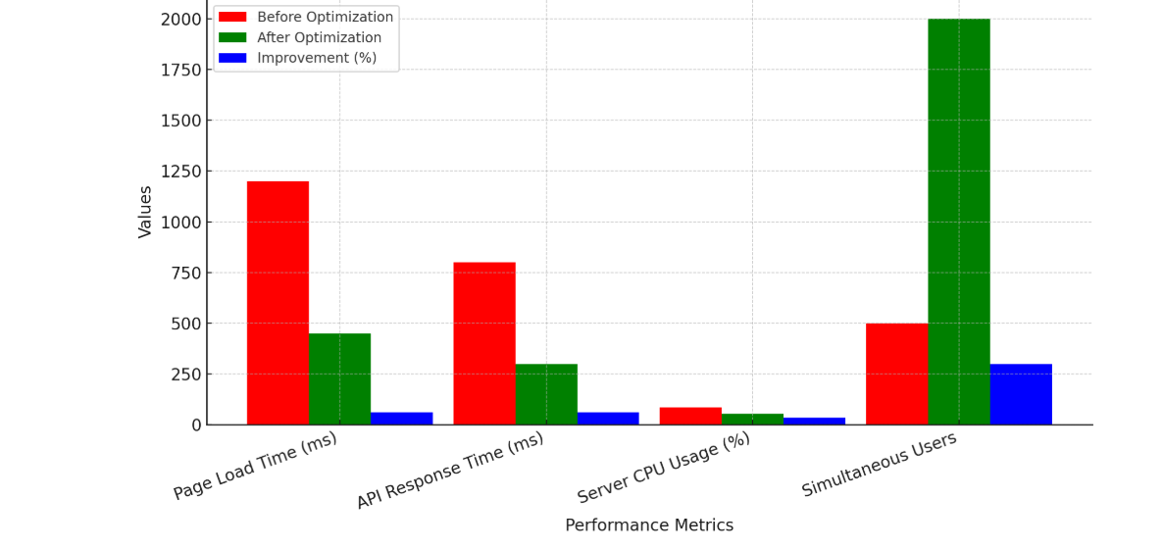

Slide 12
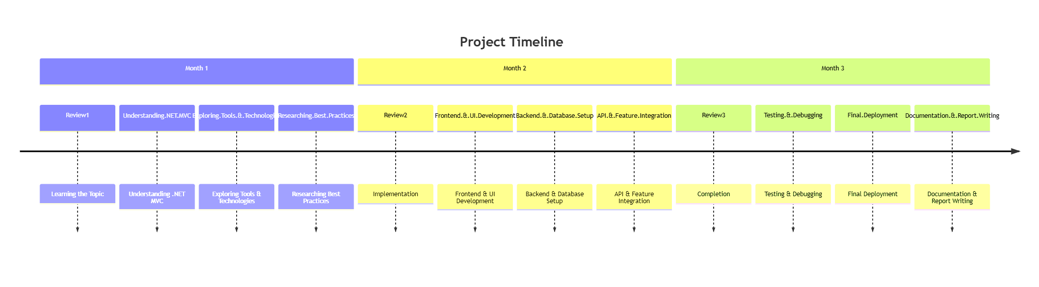
Timeline Gantt Chart

Slide 13
GitHub Link
https://github.com/Faizanmohammed215/DapperMvcDemo-RWF-Internship-.git

Slide 14
Q&A

Slide 15
Thank you !!

